Slide 1

Transformers
Presented by:
Elizer Ponio Jr.
Department of Computer Science
College of Computing and Information Technologies

Slide 2
Outline
Transfomers

Slide 3
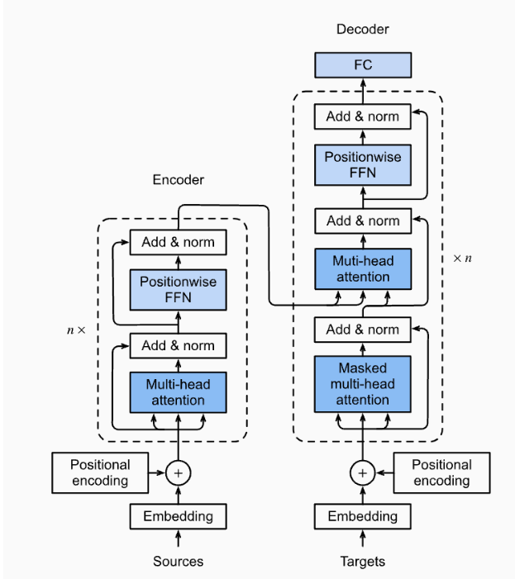
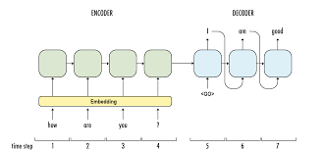
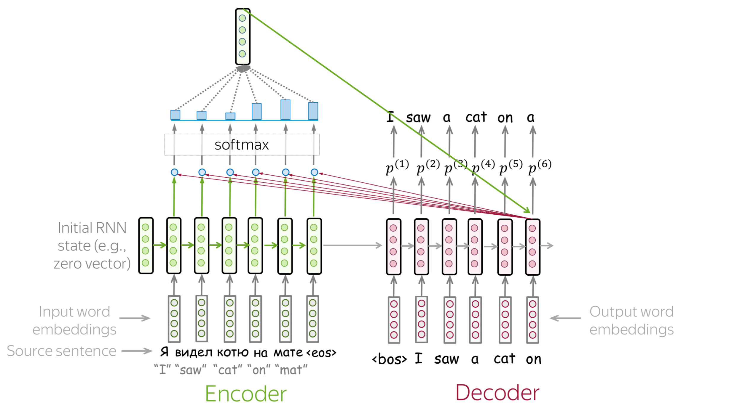
Road to Transformers
Sequence to Sequence
Attention
Transformers
So far we have discussed about Sequence to Sequence models and Attention. Today we will be learning about Transformers, which is the currently the state-of-the-art architecture for machine translation

Slide 4
Transformers

Slide 5
References

